Slide 1
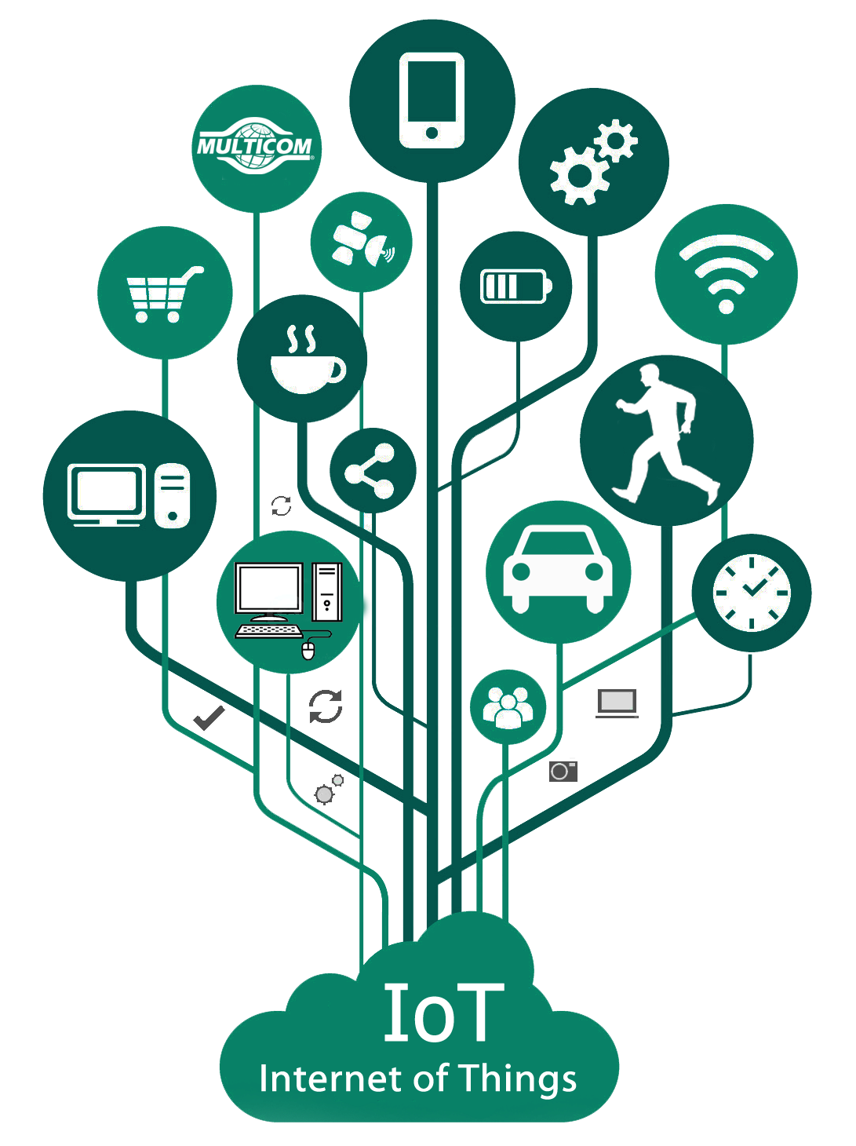
IoT Protocols
Dr. Upasana Dohare

Slide 2
Contents
Protocol Standardization for IoT – Efforts
– M2M and WSN Protocols
– SCADA and RFID Protocols
– Unified Data Standards
– Protocols – IEEE 802.15.4
– BACNet Protocol
– Modbus
– Zigbee Architecture
– Network layer – 6LoWPAN - CoAP
- Security

Slide 3
Protocol Standardization for IoT
Standardization is key to achieving universally accepted specifications and protocols for true interoperability between devices and applications.
Standard protocols define rules and formats for setting up and managing IoT networks, along with how data are transmitted across these networks.
Networking protocols can be categorized into multiple layers accordingly to the communication stack (i.e. OSI or TCP/IP model).
The use of standards:
ensures interoperable and cost-effective solutions
opens up opportunities in new areas
allows the market to reach its full potential

Slide 4
Machine to Machine (M2M)
Machine to Machine : This is commonly known as Machine to machine communication. It is a concept where two or more than two machines communicate with each other without human interaction using a wired or wireless mechanism. M2M is an technology that helps the devices to connect between devices without using internet. M2M communications offer several applications such as security, tracking and tracing, manufacturing and facility management.
M2M is also named as Machine Type Communication (MTC) in 3GPP ( 3rd Generation Partnership Project).
M2M is communication could carried over mobile networks, for ex- GSM-GPRS, CDMA EVDO Networks .

Slide 5
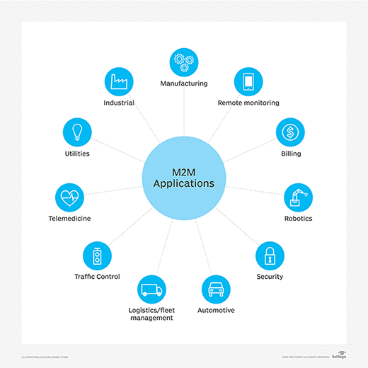
M2M applications

Slide 6
Machine to Machine (M2M)
The main components of an M2M system include sensors, RFID, a Wi-Fi or cellular communications link, and autonomic computing software programmed to help a network device interpret data and make decisions.
These M2M applications translate the data, which can trigger preprogrammed, automated actions.

Slide 7
M2M and WSN Protocols
Other M2M standards activities include:
Data transport protocol standards - M2MXML, JavaScript Object Notation (JSON), BiTXML, WMMP, MDMP
Extend OMA DM to support M2M devices protocol management objects
M2M device management, standardize M2M gateway
M2M security and fraud detection
Network API’s M2M service capabilities
Remote management of device behind gateway/firewall
Open REST-based API for M2M applications

Slide 8
SCADA (Supervisory Control and Data Acquisition)
SCADA (supervisory control and data acquisition) is a category of software applications for controlling industrial processes, which is the gathering of data in real time from remote locations in order to control equipment and conditions.
SCADA systems include hardware and software components.
The hardware gathers and feeds data into field controller systems, which forward the data to other systems that process and present it to a human-machine interface (HMI) in a timely manner.
SCADA systems also record and log all events for reporting process status and issues.
SCADA applications warn when conditions become hazardous by sounding alarms.

Slide 9
Components of a SCADA system
SCADA components include the following:
Sensors and actuators: Both sensors and actuators are controlled and monitored by SCADA field controllers.
SCADA field controllers: These interface directly connected with sensors and actuators. There are two categories of field controllers:
Remote telemetry units, also called remote terminal units (RTUs), interface with sensors to collect telemetry data and forward it to a primary system for further action.
Programmable logic controllers (PLCs) interface with actuators to control industrial processes, usually based on current telemetry collected by RTUs and the standards set for the processes.
SCADA supervisory computers: These control all SCADA processes and are used to gather data from field devices and to send commands to those devices to control industrial processes.

Slide 10
Components of a SCADA system
SCADA components include the following:
HMI software: This provides a system that consolidates and presents data from SCADA field devices and enables operators to understand and, if needed, modify the status of SCADA-controlled processes.
Communication infrastructure: This enables SCADA supervisory systems to communicate with field devices and field controllers. This infrastructure enables SCADA systems to collect data from field devices and to control those devices.

Slide 11
Common Industry Examples Of SCADA Industrial Automation
electricity generation and distribution;
oil and gas refining operations;
telecommunications infrastructure;
transportation and shipping infrastructure;
fabrication and other industrial processing;
food and beverage processing;
chemical manufacturing; and
utilities infrastructure, including water and waste control.

Slide 12
Issues with IoT Standardization
Different consortia, forums and alliances have been doing standardization in their own limited scope
For example, 3GPP covers only cellular wireless networks while EPCglobal’s middleware covers only RFID events
Even within same segment, there are more than one consortium or forum doing standardization without enough communication with each other.
Some people believe that the IoT concept is well established. However, some gray zones remain in the definition, especially which technology should be included

Slide 13
Unified Data Standards
HTML/HTTP combination of data format and exchange protocol is the foundation pillar of WWW
Described great number of data standards and protocols proposed for four pillar domains of IoT.
Many issues still impede the development of IoT and especially WoT vision.
Many standardization efforts have been trying to define unified data representation, protocol for IoT.
Before IoT, Internet was actually an Internet of documents or of multimedia documents.
Two pillars of Internet including HTML/HTTP turned the Internet into WWW.
We need to turn the IoT into the WoT.

Slide 14
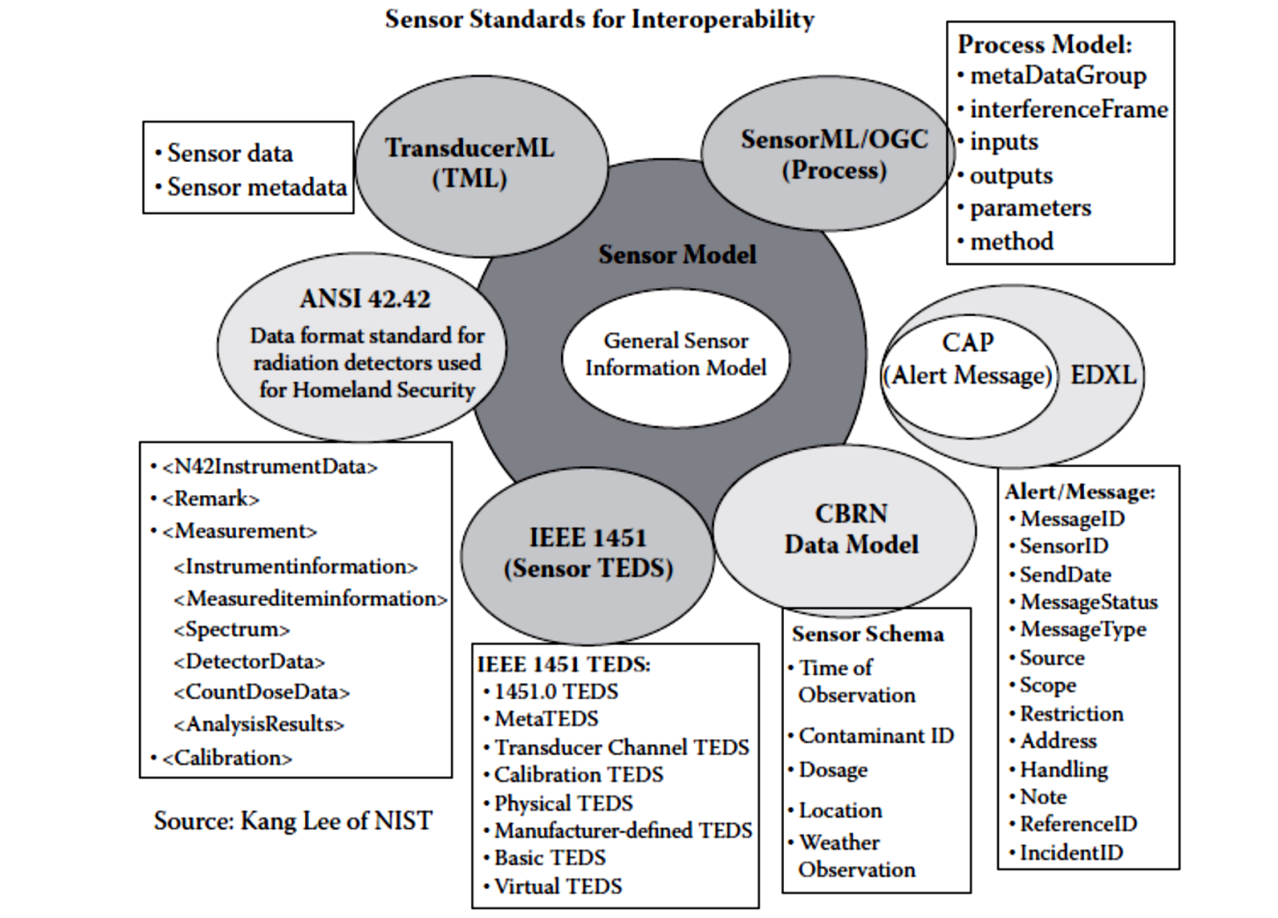
Unified Data Standards
There are many different levels of protocols
But the ones that most directly relate to business and social issues are the ones closest to the top
so-called application protocols such as HTML/HTTP for the web

Slide 15
Protocol- IEEE 802.15.4
IEEE 802.15.4 is a low-cost, low-data-rate wireless access technology for devices that are operated or work on batteries.
Defines operation of low-rate wireless personal area networks (LR-WPANs)
Specifies physical layer and media access control for LR-WPANs
Maintained by IEEE 802.15 working group, which defined the standard in 2003
Basic framework conceives a 10m communications range with a transfer rate of 250 kbit/s

Slide 16
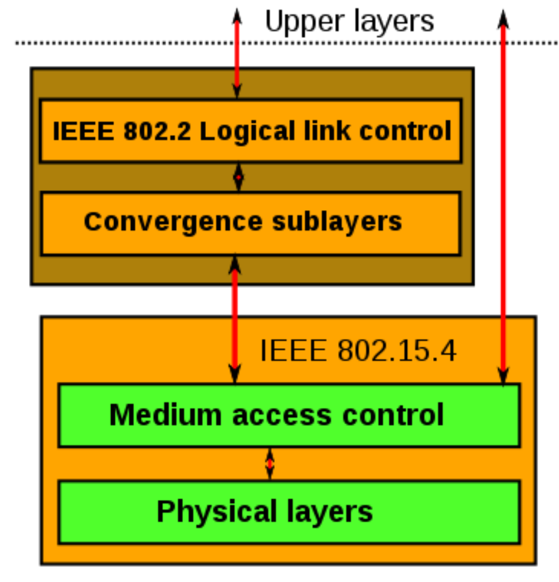
Protocol- IEEE 802.15.4
Physical Layer (PHY) provides data transmission service & interface to physical layer management entity.
MAC enables transmission of MAC frames through the use of the physical channel

Slide 17
Advantages and Applications of IEEE 802.15.4:
IEEE 802.15.4 has the following advantages:
Cost effective
long battery life,
Quick installation
simple
extensible protocol stack
IEEE 802.15.4 Applications:
Wireless sensor networks in the industry
Building and home automation
Remote controllers and interacting toys
Automotive networks

Slide 18
BACNet Protocol
BACnet is a network protocol used in building automation systems (BAS) to control the data exchange between different devices and components.
Designed to allow communication of building automation & control system for application like
Heating, Ventilating and Air-conditioning Control (HVAC)
Lighting Control, Access Control
Fire Detection Systems and their Associated Equipment

Slide 19
BACNet Protocol
Defines a number of services that are used to communicate between building devices
Protocol services include Who-Is, I-Am, Who-Has, I-Have which are used for Device & Object discovery
Services such as Read-Property and Write-Property are used for data sharing
Defines 60 object types that are acted upon by services:
Alarm and Event Services
File Access Services
Object Access Services
Remote Device Management Services
Virtual Terminal Services
Defines no. of data link/physical layers including:
ARCNET, • Ethernet, • BACnet/IP, • BACnet/IPv6, • Point-To-Point over RS-232, • Master-Slave/Token-Passing over RS-485, • ZigBee • LonTalk

Slide 20
BACNet Communication
There are 38 types of services a BACNet offers divided into:
Alarm and Event Services
File Access Services
Object Access Services
Remote Device Management Services
Virtual Terminal Services

Slide 21
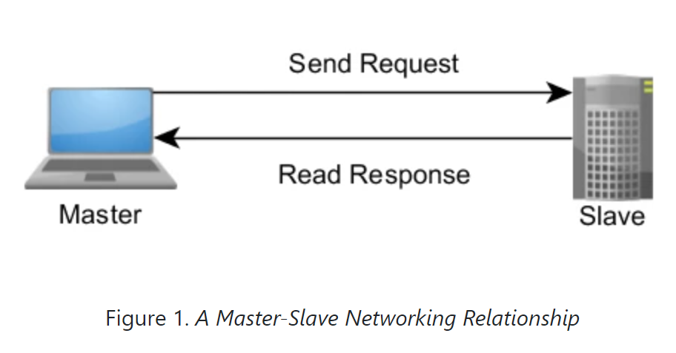
Modbus Protocol
Modbus is a request-response protocol implemented using a master-slave relationship.
In a master-slave relationship, communication always occurs in pairs—one device must initiate a request and then wait for a response—and the initiating device (the master) is responsible for initiating every interaction.
Typically, the master is a human machine interface (HMI) or Supervisory Control and Data Acquisition (SCADA) system and the slave is a sensor, programmable logic controller (PLC), or programmable automation controller (PAC).
The content of these requests and responses, and the network layers across which these messages are sent, are defined by the different layers of the protocol.

Slide 22
Modbus Protocol
Reasons for use of Modbus in industrial environment:
Developed with industrial applications in mind
Openly published and royalty-free
Easy to deploy and maintain

Slide 23
Layers of the Modbus Protocol
In the initial implementation, Modbus was a single protocol built on top of serial, so it could not be divided into multiple layers.
A later update to the standard, called Modbus TCP, describes how to use Modbus in TCP/IP networks.

Slide 24
Modbus Data Types
The Modbus Protocol supports these data types:
Data Type | Access | Description
Coil | Read-write | Single bit outputs.
Discrete Input | Read-only | Single bit inputs.
Input Register | Read-only | 16-bit input registers.
Holding Register | Read-write | 16-bit output registers.

Slide 25
Modbus Protocol Versions
Modbus RTU
Modbus ASCII
Modbus TCP/IP or Modbus TCP
Modbus over TCP/IP or Modbus over TCP or Modbus RTU/IP
Modbus over UDP
Modbus Plus (Modbus+, MB+ or MBP)
Pemex Modbus
Enron Modbus

Slide 26
ZigBee
ZigBee is a technological standard created for controlling and sensing the network.
ZigBee is an open, global, packet-based protocol designed to provide an easy-to-use architecture for secure, reliable, low power wireless networks.
IEEE802.15.4 developed the PHY and MAC layer whereas, the ZigBee takes care of upper higher layers.
ZigBee is a standard that addresses the need for very low-cost implementation of Low power devices with Low data rates for short-range wireless communications.
The ZigBee specification supports star and two kinds of peer-to-peer topologies, mesh and cluster tree.

Slide 27
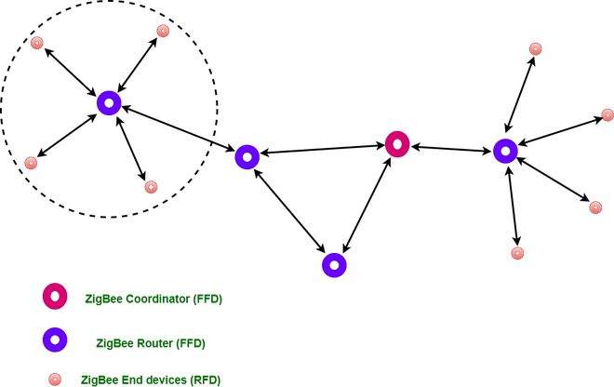
Types of ZigBee Devices:
Zigbee Coordinator Device: It communicates with routers. This device is used for connecting the devices.
Zigbee Router: It is used for passing the data between devices.
Zigbee End Device: It is the device that is going to be controlled.

Slide 28
General Characteristics of Zigbee Standard:
Low Power Consumption
Low Data Rate (20- 250 kbps)
Short-Range (75-100 meters)
Network Join Time (~ 30 msec)
Support Small and Large Networks (up to 65000 devices (Theory); 240 devices (Practically))
Low Cost of Products and Cheap Implementation (Open Source Protocol)
Extremely low-duty cycle.
3 frequency bands with 27 channels.
Operating Frequency Bands 2.4 GHz (Across the World)

Slide 29
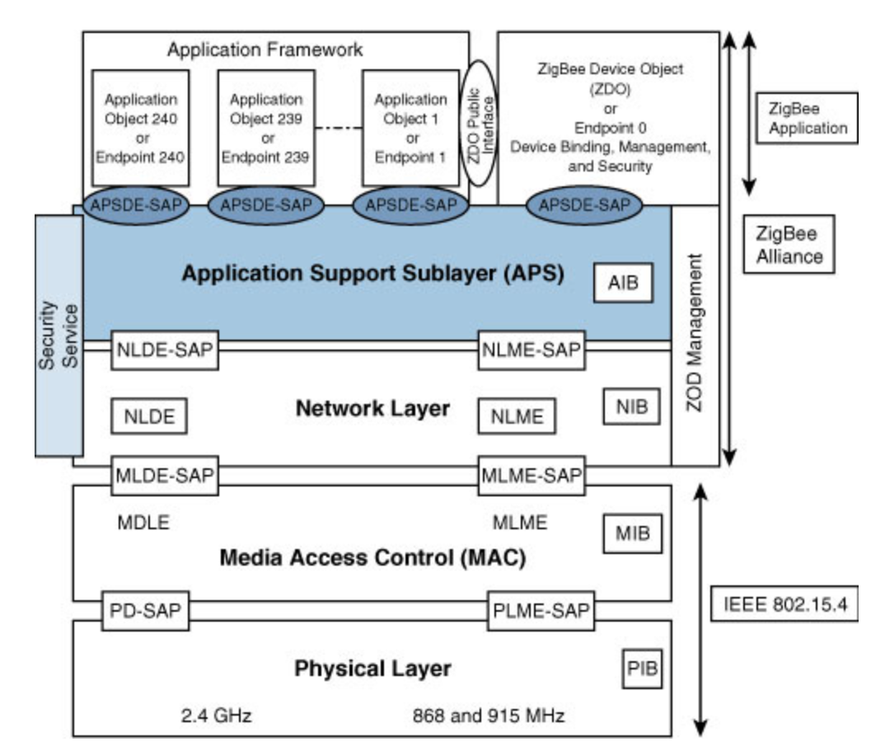
Architecture of Zigbee:
Zigbee architecture is a combination of 4 layers.
Application Support Layer (APS)
Network Layer
Medium Access Control Layer
Physical Layer

Slide 30
Architecture of Zigbee: Physical layer
Physical layer: The lowest two layers i.e the physical and the MAC (Medium Access Control) Layer are defined by the IEEE 802.15.4 specifications.
The Physical layer is closest to the hardware and directly controls and communicates with the Zigbee radio. The physical layer translates the data packets in the over-the-air bits for transmission and vice-versa during the reception.
Medium Access Control layer (MAC layer): The layer is responsible for the interface between the physical and network layer. The MAC layer is also responsible for providing PAN ID and also network discovery through beacon requests.

Slide 31
Architecture of Zigbee: Network layer
Located between the MAC layer and application support sublayer
Provides the following functions:
Starting a network
Managing end devices joining or leaving a network
Route discovery
Neighbour discovery

Slide 32
Architecture of Zigbee : APS layer
The APS layer in the Zigbee stack is the highest protocol layer and it consists of the application support sub-layer and Zigbee device object.
APS is responsible for the following activities:
Filtering out packets for non-registered endpoints, or profiles that don't match
Generating end-to-end acknowledgment with retries
Maintaining the local binding table
Maintaining the local groups table
Maintaining the local address map

Slide 33
6LoWPAN (IPv6 over Low power Wireless Personal Area Networks)
The name 6LoWPAN is derived from the Internet Protocol version 6 (IPv6) over Low power Wireless Personal Area Networks”.
This protocol works on Wireless Personal Area Network i.e., WPAN.
WPAN is a Personal Area Network (PAN)/Mesh Network where the interconnected devices are centered around a person’s workspace.
It is a communication protocol that enables small, low-power devices to communicate with each other over a wireless network.
The protocol was designed to work with small, resource-constrained devices like sensors, and wearable technology that should be able to participate in the Internet of Things

Slide 34
How Does 6LoWPAN Work?
6LoWPAN works by encapsulating IPv6 packets into smaller frames that can be transmitted over a low-power wireless network.
The protocol uses header compression to reduce the size of the packets, making it possible for small, low-power devices to send and receive data.
In addition, the 6LoWPAN protocol is made to function with other IoT networking standards including Bluetooth, Wi-Fi, and Zigbee.
This enables seamless communication between 6LoWPAN devices and devices that employ various networking technologies.

Slide 35
Basic Requirements of 6LoWPAN:
Low power, IP-driven nodes, and large mesh network support make this technology a great option for IoT.
The device should be having sleep mode in order to support the battery saving.
Minimal memory requirement.
Routing overhead should be lowered.

Slide 36
6LoWPAN: Features
It is used with IEEE 802.15,.4 in the 2.4 GHz band.
Outdoor range: ~200 m (maximum)
Data rate: 200kbps (maximum)
Maximum number of nodes: ~100

Slide 37
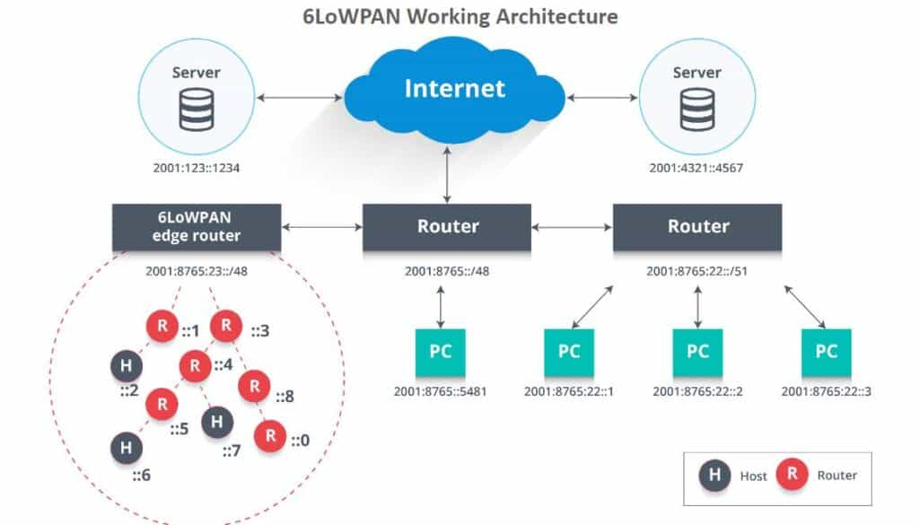
6LoWPAN: Network Architecture
Explanation of the diagram:
The uplink to the Internet is handled by the IPv6 router.
It comprises an Edge Router and Sensor Nodes. Even the smallest of the IoT devices can now be part of the network, and the information can be transmitted to the outside world as well.
The 6LoWPAN network is connected to the IPv6 network using an edge router.
The edge router handles three actions:
The data exchange between 6LoWPAN devices and the Internet (or other IPv6 network).
Local data exchange between devices inside the 6LoWPAN.
The generation and maintenance of the radio subnet (the 6LoWPAN network).
By communicating natively with IP, 6LoWPAN networks are connected to other networks using IP routers.

Slide 38
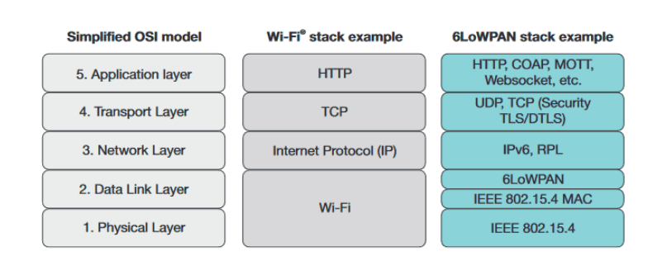
6LoWPAN: System Stack Overview
A complex application-layer gateway is needed to make devices such as ZigBee, Bluetooth, and proprietary systems connect to the Internet.
6LoWPAN solves this dilemma by introducing an adaptation layer between the IP stack’s link and network layers to enable the transmission of IPv6 datagrams over IEEE 802.15.4 radio links.

Slide 39
Advantages of 6LoWPAN
It works great with open IP standard including TCP, UDP, HTTP, COAP, MATT and web-sockets.
It offers end-to-end IP addressable nodes. There’s no need for a gateway, only a router which can connect the 6LoWPAN network to IP.
It supports self-healing, robust and scalable mesh routing.
Offers one-to-many & many-to-one routing.
The 6LoWPAN mesh routers can route data to others nodes in the network.
In a 6LowPAN network, leaf nodes can sleep for a long duration of time.

Slide 40
Disadvantages of 6LoWPAN:
It has lesser immunity to interference than that Wi-Fi and Bluetooth.
Without the mesh topology, it supports a short range.

Slide 41
Applications of 6LoWPAN:
It is a wireless sensor network.
It is used in home-automation,
It is used in smart agricultural techniques, and industrial monitoring.
It is utilised to make IPv6 packet transmission on networks with constrained power and reliability resources possible.

Slide 42
Security and Interoperability with 6LoWPAN:
Security: 6LoWPAN security is ensured by the AES (Advance Encryption Standard)algorithm, which is a link layer security, and the transport layer security mechanisms are included as well.
Interoperability: 6LoWPAN is able to operate with other wireless devices as well which makes it interoperable in a network

Slide 43
What is CoAP (Constrained Application Protocol)?
Constrained Application Protocol (CoAP) is a specialized web transfer protocol for use with constrained nodes and constrained networks in the Internet of Things.
CoAP is designed to enable simple, constrained devices to join the IoT even through constrained networks with low bandwidth and low availability.

Slide 44
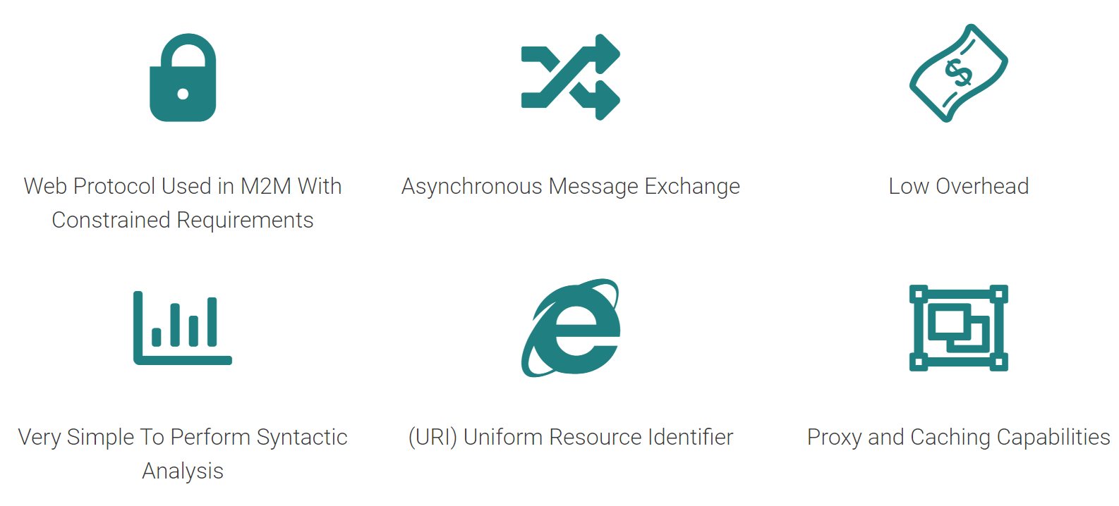
CoAP Features

Slide 45
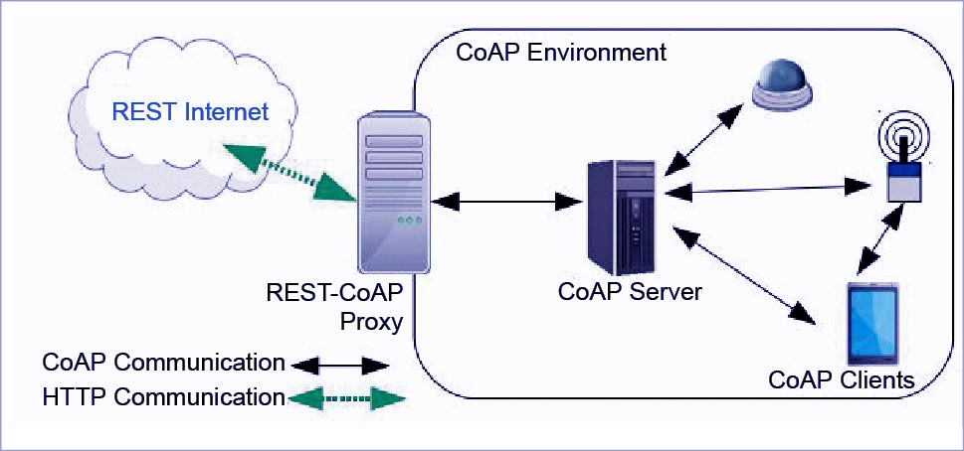
Architecture of CoAP
The whole architecture of CoAP consists of CoAP client, CoAP server, REST CoAP proxy, and REST internet.
The data is sent from CoAP clients (such as smartphones, RFID sensors, etc.) to the CoAP server and the same message is routed to REST CoAP proxy.
The REST CoAP proxy interacts outside the CoAP environment and uploads the data over REST internet.

Slide 46
How Does CoAP Function?
CoAP functions as a sort of HTTP for restricted devices, enabling equipment such as sensors or actuators to communicate on the IoT.
These sensors and actuators are controlled and contribute by passing along their data as part of a system.
COAP uses UDP as the underlying network protocol. COAP is basically a client-server IoT protocol where the client makes a request and the server sends back a response as it happens in HTTP.
The methods used by COAP are the same used by HTTP.

Slide 47
KNX Protocol
KNX is a communication protocol developed for — and widely used in —home and building automation.
It is a standardized (EN 50090, ISO/IEC 14543), OSI-based network communications protocol that is administered by the KNX Association.
KNX defines several physical communication media:
Twisted pair wiring (inherited from the BatiBUS and EIB Instabus standards)
Powerline networking (inherited from EIB and EHS– similar to that used by X10)
Radio Frequency (KNX-RF)
Infrared
Ethernet (also known as EIBnet/IP or KNXnet/IP)

Slide 48
KNX System Components
All the devices for a KNX installation are connected together by a two wire bus to exchange data
Sensors
Actuators
System devices and components

Slide 49
What is IoT Security?
IoT security (internet of things security) is the technology segment focused on safeguarding connected devices and networks in IoT.
IoT involves adding internet connectivity to a system of interrelated computing devices, mechanical and digital machines, objects, animals and people.
Each thing has a unique identifier and the ability to automatically transfer data over a network. However, enabling devices to connect to the internet opens them up to serious vulnerabilities if they aren't properly protected.

Slide 50
Why is IoT security important?
Due to the unconventional manufacturing of IoT devices and the vast amount of data they handle, there's a constant threat of cyber attacks.
Several high-profile incidents where a common IoT device was used to break into and attack the larger network have drawn attention to the need for IoT security.
The ever-looming possibility of vulnerabilities, data breaches and other risks associated with IoT device usage underscores the urgent need for strong IoT security.

Slide 51
IoT security issues and challenges
The following IoT security challenges:
Remote exposure. IoT devices have a particularly large attack surface due to their internet-supported connectivity. While this accessibility is extremely valuable, it also gives hackers the opportunity to interact with devices remotely. This is why hacking movements, such as phishing, are particularly effective.
Resource constraints. Not all IoT devices have the computing power to integrate sophisticated firewalls or antivirus software.
Multiple connected devices. Most households today have multiple interconnected devices. The drawback of this convenience is that, if one device fails due to a security misconfiguration, the rest of the connected devices in the same household go down as well.
Lack of encryption. Most network traffic originating from IoT devices is unencrypted, which increases the possibility of security threats and data breaches.

Slide 52
How to protect IoT systems and devices?
Introduce IoT security during the design phase
PKI can secure client-server connections between multiple networked devices.
Using a two-key asymmetric cryptosystem, PKI can facilitate the encryption and decryption of private messages and interactions using digital certificates.
Protecting an IoT network using antimalware, firewalls, intrusion detection systems and intrusion prevention systems; blocking unauthorized IP addresses; and ensuring systems are patched and up to date.
Making API security necessary for protecting the integrity of data being sent from IoT devices to back-end systems and ensuring only authorized devices, developers and apps communicate with APIs.

Slide 53
What attacks are IoT devices most susceptible to?
The following are attacks that are most vulnerable:
Firmware vulnerability exploits
Credential-based attacks
Physical hardware-based attacks

Slide 54
What are some of the main aspects of IoT device security?
Main aspects of IoT devices security are
Software and firmware updates
Credential security
Device authentication
Encryption
Turning off unneeded features

